Slide 1
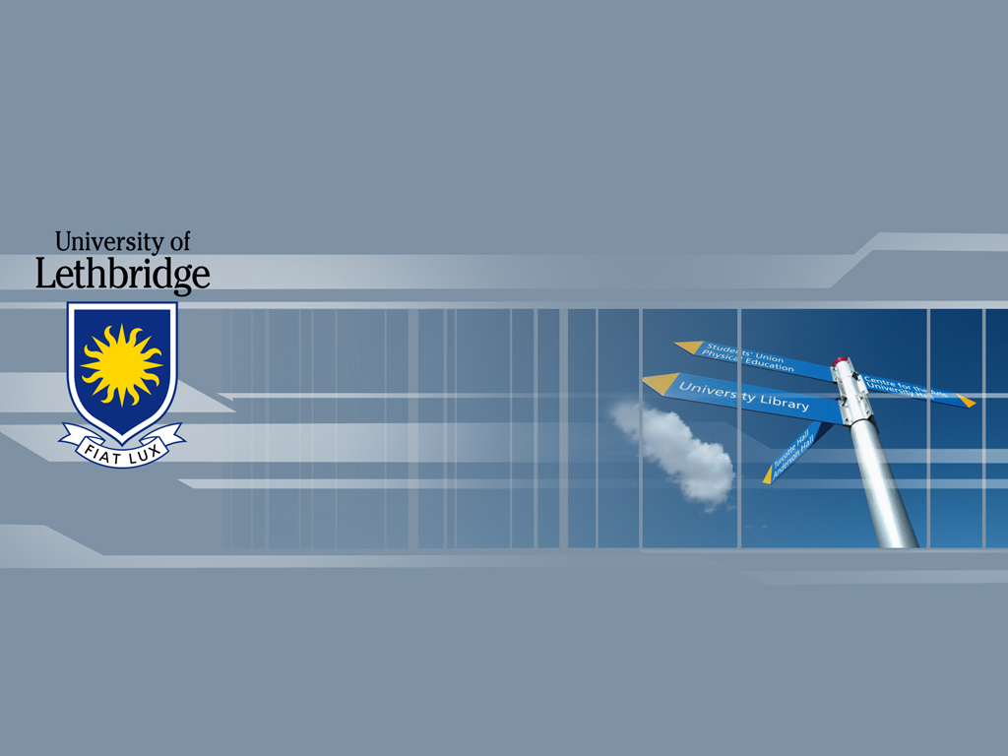
Networks
Information Systems and Management

Slide 2
Telecommunications
Definition:
  The exchange of data in any form (voice, data, text, images) over computer-based networks.

Slide 3
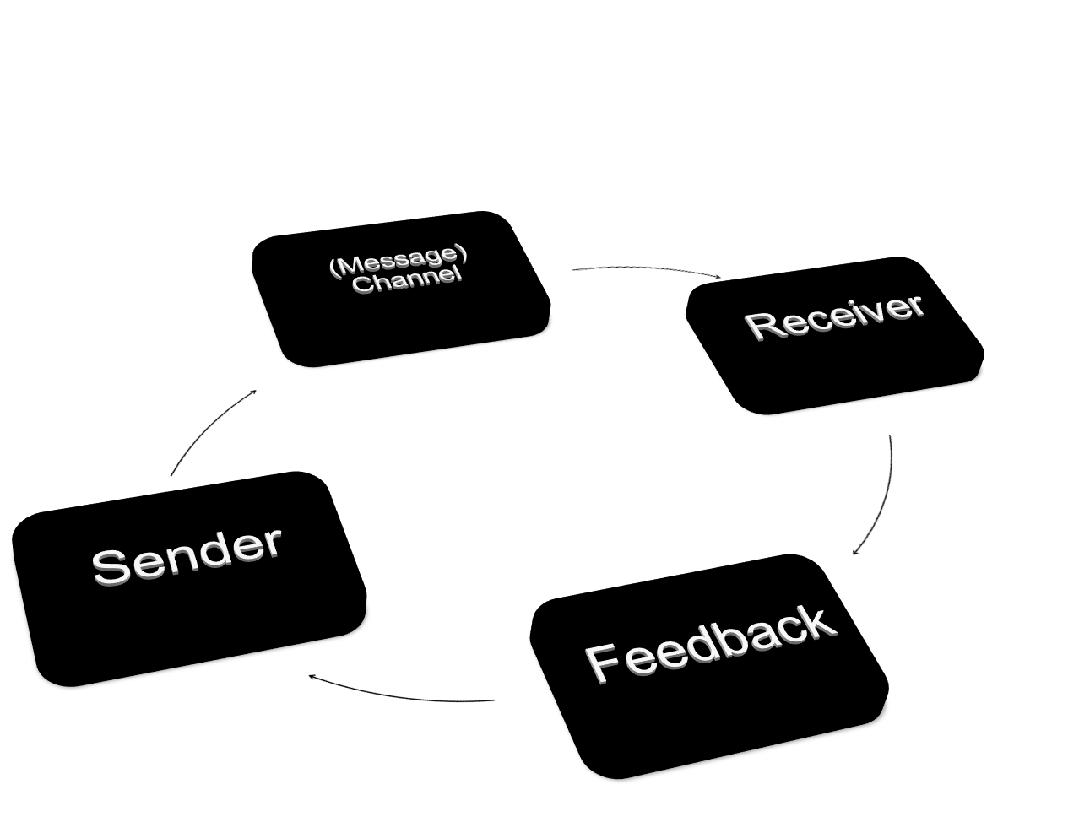

Slide 4
Protocol
Definition:
  The rules and procedures that govern transmission between the components in a network.

Slide 5

Types of Signals
Analog
  Continuous wave form (voice)
Digital
  Data is coded into two discrete states (1 and 0)
Modem
  Translates from one type to the other
  Modulate/demodualte

Slide 6
Communication Channels
Definition:
  The links by which data or voice are transmitted between sending and receiving devices in a network

Slide 7
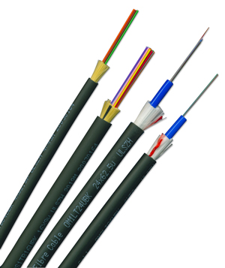
Land Line
Twisted Wire
  copper wire, analog transmission
Coaxial Cable
  Thicker copper wire, larger data volumes and greater transmission speed
Fiber Optics
  Clear glass fibers, fast, light and durable

Slide 8
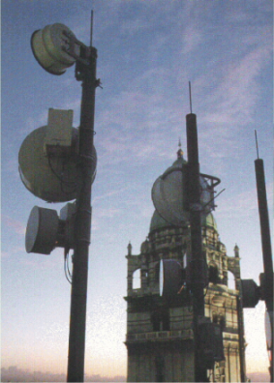
Wireless Transmission
Microwave
  High volume
  Long distance
  Point-to-point (straight line-stations 25-30 miles apart)
  High frequency radio signals
Satellite
  Orbiting relays for transmitting microwave signals
Infrared
  Wireless LANs

Slide 9
Transmission Speed
Baud Rate
  Change in signal from + to – or vice versa
Bandwidth
  Capacity of a communication channel as measured by the difference between the highest and lowest frequencies that can be transmitted by that channel

Slide 10
Transmission Modes
Asynchronous
  Low speed transmission of one character at a time (need start, stop, and parity bits)
Synchronous
  High speed simultaneous transmissions of large blocks of data (clock at each end)

Slide 11
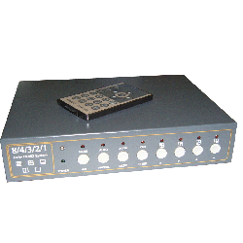
Communication Processors
Hardware that supports data transmission and reception in a telecommunications network

Slide 12
Communications Processors
Front-end Processor
  Small computer managing the communications for the host computer in a network
Concentrator (open and close channel)
  Computer that collects and temporarily stores messages for batch transmission
Multiplexer (channel always open)
  Enables a single channel to carry data transmissions from multiple sources

Slide 13
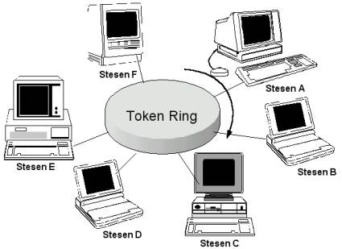
Access Methods
Polling
Contention
Token Passing

Slide 14
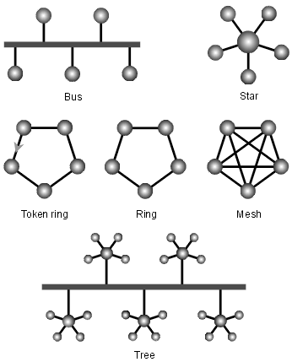
Telecommunication Networks
Topology
  The shape or configuration of a network

Slide 15
Network Topologies
Star: all computers are connected to a central host
Ring: computers are linked by a closed loop
Bus: all messages are broadcast to the entire network and each device identifies messages sent to it

Slide 16

Connectivity
Open Systems Interconnect (OSI)
  Link different type of networks
Transmission Control Protocol (Internet Protocol (TCP/IP))
  US Department of Defense
Systems Network Architecture (SNA)
  IBM proprietary model
Integrated Services Digital Network (ISDN)
  Standard for phone lines

Slide 17
Types of Telecommunication Networks
WAN
MAN
LAN
VAN
Intranet
Extranet
VPN
Client/Server Network

Slide 18

Trends
Open Systems
Connectivity
Interoperability
Digital
Wireless

Slide 19
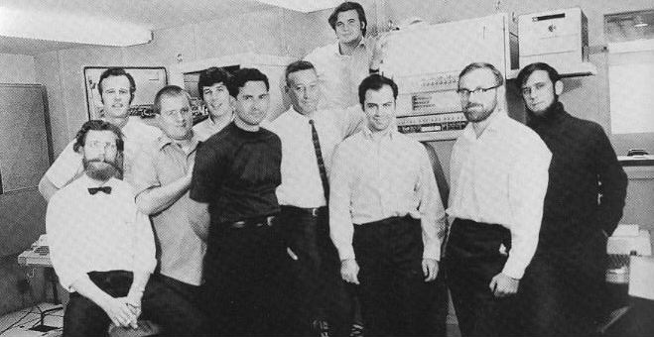
The Internet Revolution
Started as ARPANET in 1969
By the U.S. Dept. of Defense
Back up communications network
    Internet Applications
      E-mail
      Browsers
      News Groups
      Chat Rooms
ARPANET installation team, 1971

Slide 20




The Information
Super Highway
U.S. Interstate Highway system
The Internet
* Both were formed for military purposes!

Slide 21
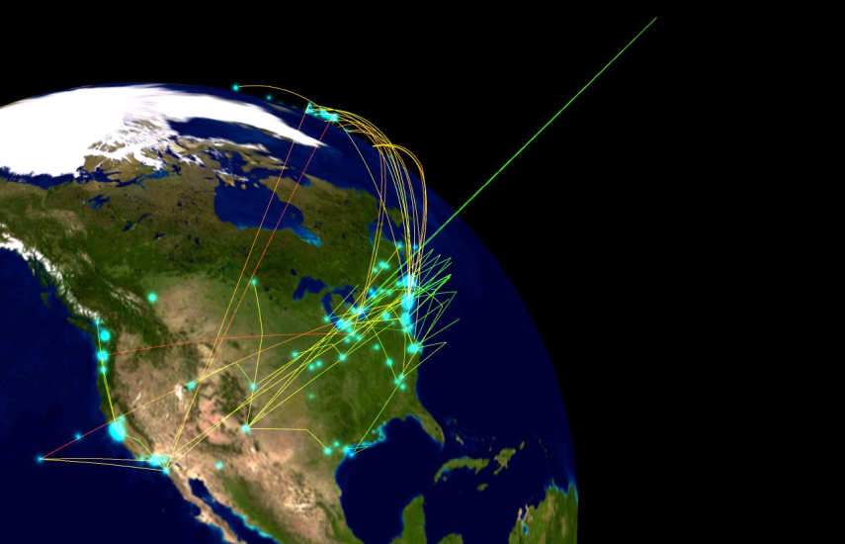
Business Use of the Internet
Enterprise Communications and Collaboration
E-Commerce
    Sales over the internet
    Collect payments online
    Gather marketing data

Slide 22

Business Use of the Internet
Strategic Business Alliances
    Through the distribution chain
    Market sharing
      Airlines
    Virtual Companies
      CIM
      IE³

Slide 23
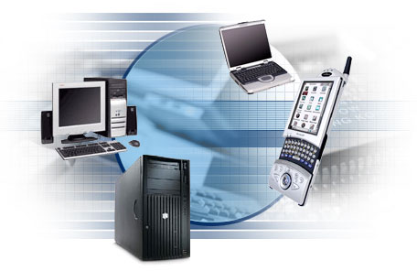
My Uses of the Internet
Baseball Game Tickets
Car Prices
Listen to Robb broadcast hockey
Distance Education (CIM, Capella)
VOIP
Skype

Slide 24
Networks
Information Systems and Management

